Slide 1
WHO Latest Recommendation on ANC
Prof. dr. Mohammad Hakimi, SpOG(K), PhD.
Divisi Obstetri-Ginekologi Sosial
Departemen Obstetri-Ginekologi
Fakultas Kedokteran, Kesehatan Masyarakat dan Keperawatan
Universitas Gadjah Mada

Slide 2
“Traditional” ANC
Gestational age | Frequency | No. of visits
Up to 28 weeks 28-36 weeks 36-40 weeks | Monthly Once every two weeks Weekly | 7 4 4
 | Total | 15

Slide 3
ANC and Maternal Mortality
Antenatal care clinics started in US, Australia, Scotland between 1910–1915
New concept - screening healthy women for signs of disease
By 1930’s large number (1200) ANC clinics opened in UK
No reduction in maternal mortality
However, widely used as a maternal mortality reduction strategy in 1980’s and early 1990’s
Is ANC important? YES!!
Early detection of problems and birth preparation

Slide 4
Maternal Mortality: UK 1840–1960
Improvements in nutrition, sanitation
Antenatal care
Antibiotics, banked blood, surgical improvements
Maine 1999.

Slide 5
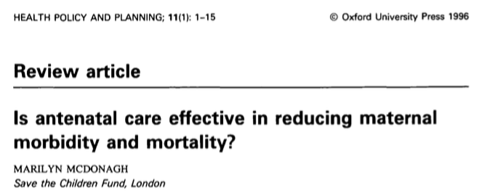

Slide 6
Carroli G, Rooney C and Villar J. How effective is antenatal care in preventing maternal mortality and serious morbidity? An overview of the evidence. Paediatric and Perinatal Epidemiology 2001, 15 (Suppl. 1), 1-42.
What is striking in examining the evidence for or against the effectiveness of care during pregnancy in reducing maternal mortality or serious morbidity is how little is known.
Reports on antenatal care emphasise the same fundamental lack of certainty about the efficacy of many established practices.

Slide 7
Antenatal Care
Continuum of quality care
Antenatal period:
Health promotion
Disease prevention
Early detection and treatment for complications
Birth preparedness
Complication readiness

Slide 8
WHO ANC Model – 1
Specific evidence-based interventions for all women
Carried out at four critical times
Focused Antenatal Care Model (FANC)

Slide 9
WHO ANC Model – 2
Two groups of women
Basic component: routine ANC
Intended for women who do not have evidence of complications/risk factors.
Special care: Women who need additional assessment/care etc.
The assumption: 25% of the women – special care
Follow specific guidelines

Slide 10
WHO ANC Model – 3
Critical times:
8-12weeks
24-26weeks
32weeks
36-38weeks
Goals and activities:
History
Examination
Screening and tests
Treatments
Preventive measures
Health promotion/counseling

Slide 11
WHO ANC Model – 4
Rwanda
Kenya
Mozambique
Madagascar
Ethiopia
Uganda
Thailand
Philippines
Cambodia
China
Papua New Guinea
Afghanistan
Djibouti
Egypt
Iraq
Morocco
Pakistan
Somalia
Sudan
Yemen
Armenia
Kyrgyzstan

Slide 12
WHO ANC Model – 5
Updated Cochrane review and secondary analysis of the WHO trial suggest fewer visits may be associated with increased fetal death
Actual content of and the demand for antenatal care is at best variable in different settings
DHS analysis (41 countries): Quality coverage gaps for recommended elements of care for most countries, with the exception of BP measurement

Slide 13
The 2016 ANC guideline
Essential core package of ANC that all pregnant women and adolescent girls should receive
With the flexibility to employ different options based on the context of different countries
What is the content of the model/package?
Who provides care?
Where is the care provided?
How is the care provided to meet the needs of the users?
Complement existing WHO guidance on complications during pregnancy

Slide 14
The 2016 ANC guideline
Overarching questions
What are the evidence-based practices during ANC that improved outcomes and lead to positive pregnancy experience?
How should these practices be delivered?

Slide 15
« To achieve the Every Woman Every Child vision and the Global Strategy for Women's, Children's and Adolescents' Health, we need innovative, evidence-based approaches to antenatal care. I welcome these guidelines, which aim to put women at the centre of care, enhancing their experience of pregnancy and ensuring that babies have the best possible start in life. »
Ban Ki-moon, United Nations Secretary-General

Slide 16
Types of recommendations
We recommend the option
We recommend this option under certain conditions
Only in the context of rigorous research
Only with targeted monitoring and evaluation
Only in specific contexts
We do not recommend this option
Notes:
The GDG made three types of recommendations.

Slide 17
Recommendations on ANC
49 recommendations were grouped into five topic areas:
Nutritional interventions (14)
Maternal and fetal assessment (13)
Preventive measures (7)
Interventions for common physiological symptoms (6)
Health systems interventions to improve the utilization and quality of ANC (9)
Including 10 recommendations relevant to routine ANC from other WHO guidelines

Slide 18
Summary list of WHO recommendations on antenatal care (ANC) for a positive pregnancy experience

Slide 19
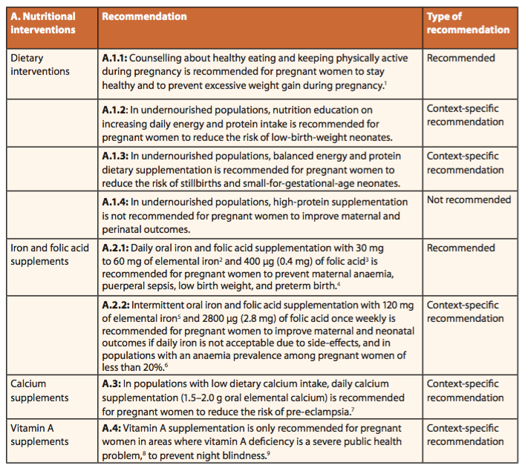

Slide 20
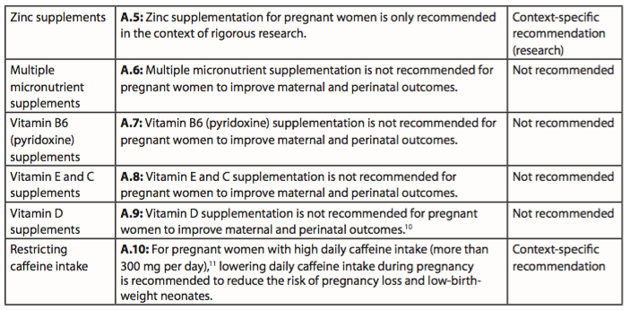

Slide 21
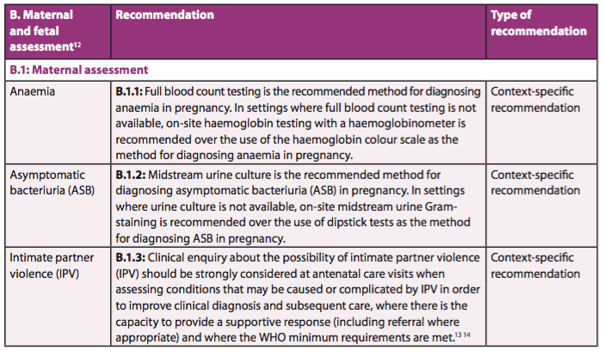

Slide 22
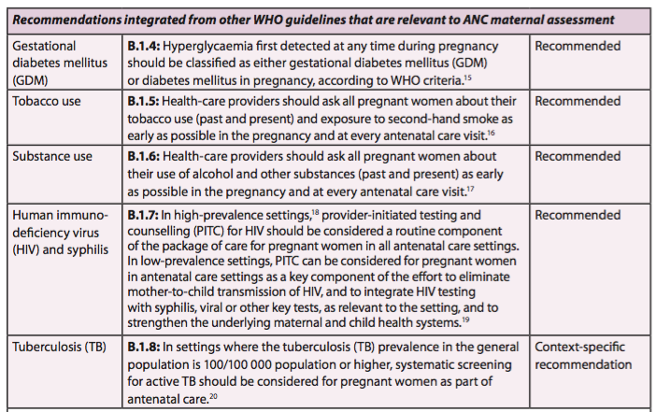

Slide 23
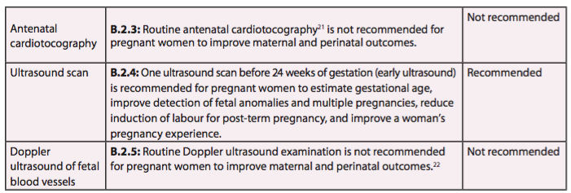

Slide 24
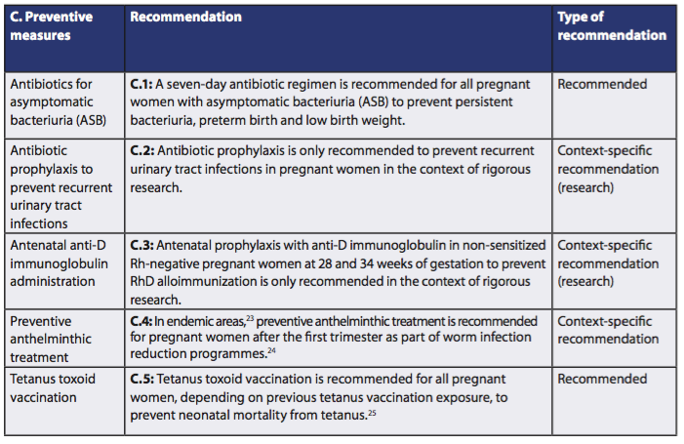

Slide 25
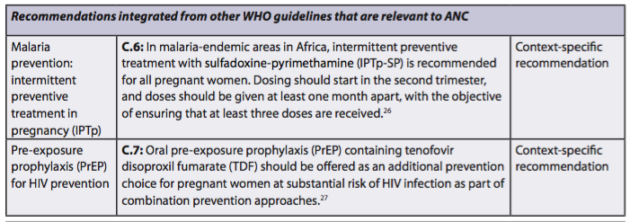

Slide 26
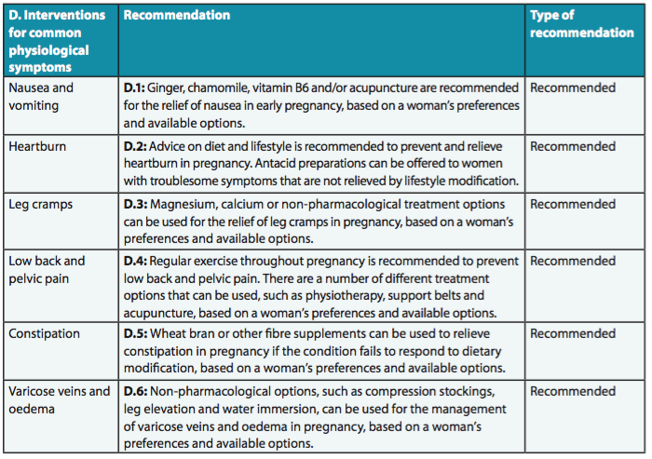

Slide 27
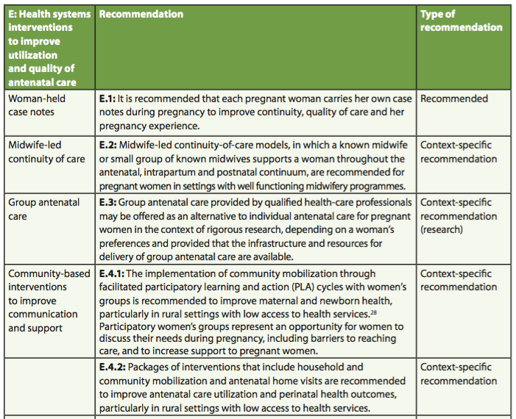

Slide 28
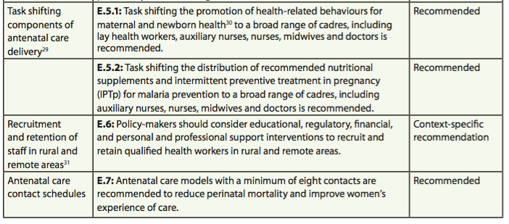

Slide 29
WHAT's NEW?
Antenatal care models with a minimum of eight contacts are recommended to reduce perinatal mortality and improve women’s experience of care.
The guideline uses the term ‘contact’ - it implies an active connection between a pregnant woman and a health care provider that is not implicit with the word ‘visit’.
Quality care including medical care, support and timely and relevant information.

Slide 30
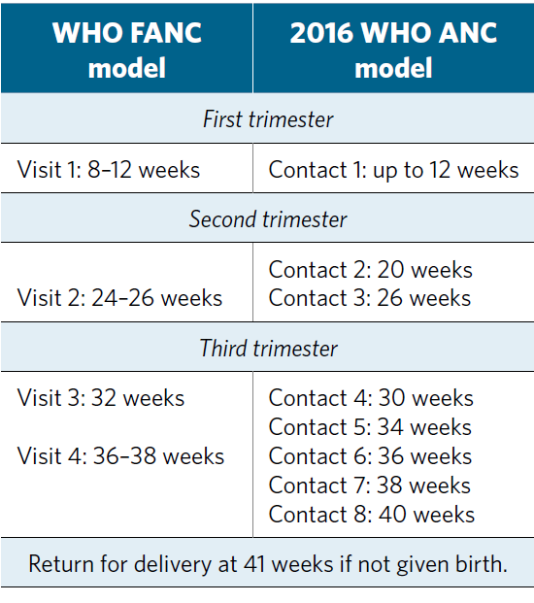
2016 WHO ANC model

Slide 31
WHAT's NEW?
Ultrasound scan:
In the new WHO ANC guideline, an ultrasound scan before 24 weeks’ gestation is recommended for all pregnant women to:
estimate gestational age
detect fetal anomalies and multiple pregnancies
enhance the maternal pregnancy experience
An ultrasound scan after 24 weeks’ gestation (late ultrasound) is not recommended for pregnant women who have had an early ultrasound scan.
Stakeholders should consider offering a late ultrasound scan to pregnant women who have not had an early ultrasound scan.

Slide 32
WHAT's NEW?
ANC model – positive pregnancy experience
Overarching aim
To provide pregnant women with respectful, individualized, person-centred care at every contact, with implementation of effective clinical practices (interventions and tests), and provision of relevant and timely information, and psychosocial and emotional support, by practitioners with good clinical and interpersonal skills within a well functioning health system.

Slide 33
WHAT's NEW?
Effective implementation of ANC requires
Health systems approach and strengthening
Continuity of care
Integrated service delivery
Improved communication with, and support for women
Availability of supplies and commodities
Empowered health care providers
Recruitment and retention of staff in rural and remote areas
Capacity building

Slide 34
Continuum of care Connecting care during the lifecycle (A) and at places of caregiving (B).

Slide 35
Kikuchi K, Ansah EK, Okawa S, et al. Effective Linkages of Continuum of Care for Improving Neonatal, Perinatal, and Maternal Mortality: A Systematic Review and Meta-Analysis. PLoS ONE 10(9): e0139288.
Our review suggests that continuous uptake of antenatal care, skilled birth attendance, and postnatal care is necessary to improve MNCH outcomes in low- and middle-income countries.
The review was conclusive for the reduction of neonatal and perinatal deaths.
Although maternal deaths were not significantly reduced, composite measures of all mortality were.
Thus, the evidence is sufficient to scale up this intervention package for the improvement of MNCH outcomes.

